Slide 1
Personal Billboard
Mission 7

Slide 2

Pre-Mission Preparation
Have you ever made a sign to post on a door or wall? How about a name badge to wear? Or a cap or t-shirt with a message or slogan on it?
If you could show what you like or your mood by displaying something, what would you display? (example: a color, an image, a slogan, etc.)
What type of clothing would you display your message on?

Slide 3

Mission 7: Personal Billboard
In this project you'll use the CodeX display and buttons to make a billboard that shows others how you're feeling, a fun picture, or a short message.
On battery power, you could make the CodeX into a wearable electronic badge or a portable sign for a wall or desk!

Slide 4
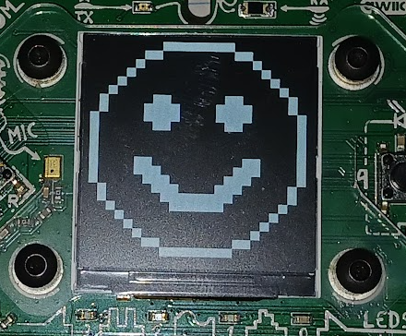
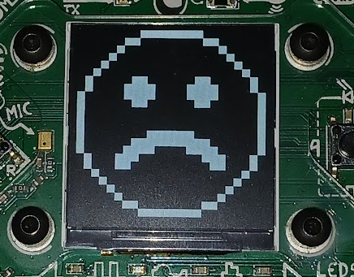
Objective #1: Image selector
The CodeX has several built-in images. You have used them since Mission 2.
You learned about using buttons for input in Mission 6.
Start this project by writing code that will:
  Display the HAPPY face when BTN_L is pressed
  Display the SAD face when BTN_R is pressed

Slide 5
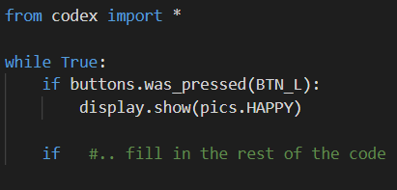
Mission Activity #1
DO THIS:
Start a new file named
Billboard
Import codex
Use a while True: loop
Show pics.HAPPY if BTN_L was pressed
Show pics.SAD if BTN_R was pressed
  Use CodeTrek if you need help

Slide 6
Objective #2: Select more images
You will use the CodeX to display your mood, so you need more than two pictures!
You will still use the LEFT and RIGHT buttons to scroll through the pictures
So you need some way to keep track of which picture to display
You will use the variable choice to keep track of which image to display, and update choice with the buttons

Slide 7
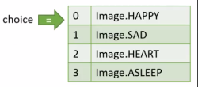
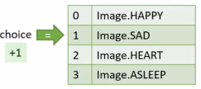
Objective #2: Select more images
You can use a number to keep track of the images like this:
A number like this is called an index. It is like using your finger to point to the image!

Slide 8
Objective #2: Select more images
Concept:
Comparison operator
To compare a number to a specific value, use ==
choice == 1
Use this comparison in an if statement to display an image
Use an if statement for each picture
You will have 4 additional if statements
Use HAPPY, SAD, and two more pictures
= assigns a value
count = 1
== compares two values to see if they are the same
if choice == 1
Comparison operators:
Greater than >
Less than <
Greater than or equal to >=
Less than or equal to <=
Equal to ==
Not equal to !=

Slide 9
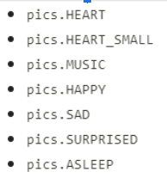
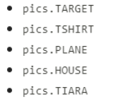
Objective #2: Select more images
Built-in images you can use:

Slide 10
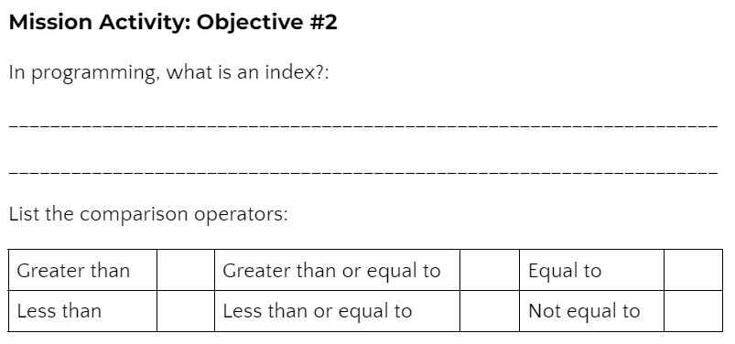
Mission Activity #2
DO THIS:
Go to your Mission Log and answer the questions about index and comparison operators

Slide 11
Mission Activity #2
DO THIS:
Define the variable choice and assign it the value 0
Write an if statement to display HAPPY (if choice == 0:)
Write an if statement to display SAD (if choice == 1:)
Write an if statement to display another pic (if choice == 2:)
Write an if statement to display another pic (if choice == 3:)
Change the if buttons.was_pressed(BTN_R) code to increment choice (choice = choice + 1)
Try to do the code on your own, and then check your work with the next slide.

Slide 12
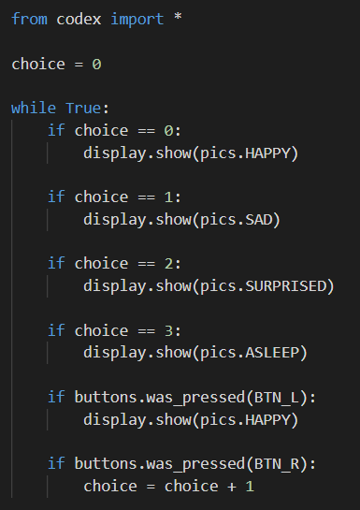
Mission Activity #2
Your code should look like this:
The last two pictures will be the ones you chose.
BTN_L isn’t changed
BTN_R increments choice

Slide 13
Objective #3: Scroll both directions
In Mission 6, you learned about increment and decrement
Increment:
  Increase the value of a variable by a set amount
  Example: num = num + 1
Decrement:
  Decrease the value of a variable by a set amount
  Example: num = num - 1
You will change the code for BTN_L to decrement choice so you can scroll the opposite way.

Slide 14

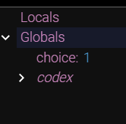


Objective #3: Scroll both directions
Another awesome feature of the debugger is that you can watch your variables and track their values while the code is running.
Start the debugger
Open the console panel
Watch the variables as you
step through the code

Slide 15
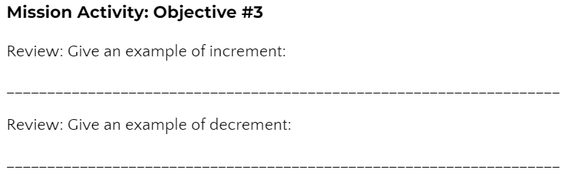
Mission Activity #3
DO THIS:
Go to your Mission Log and review “increment” and “decrement” from Mission 6

Slide 16
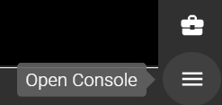


Mission Activity #3
DO THIS:
Change the code for BTN_L to decrement choice by 1
Start the debugger
Open the console panel
Use the Step In button to run the code.
  Click several times, and then press BTN_R. Check the value
  of choice.
  Click several more times, and then press either BTN_R or
  BTN_L. Check the value of choice.
  Continue as long as you want until you understand the code.
  Then STOP the code.

Slide 17

Billboard checkpoint
During this mission you have learned to use an index, review increment and decrement the counter, and used the debugger.
Answer the 3 quiz questions about the Objectives 1-3
CODEX
QUIZ

Slide 18
Objective #4: Wrap around
You probably noticed that if you keep pressing BTN_R, it stops at the last image.
The value of choice keeps increasing, but the image stays the same.
Also, pressing BTN_L many times keeps the first image on the screen.
The value of choice decreases, but the image stays the same.

Slide 19
Objective #4: Wrap around
There are no if statements for choice == 4 or choice == -1
So the last image displayed remains on the screen
Can you improve the program and avoid this problem?

Slide 20
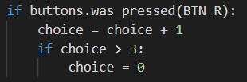
Objective #4: Wrap around
Instead of adding more images or
if statements, make the value of choice wrap-around to the first value.
Use an if statement to know when to wrap around.
Use a comparison operator.
You can have an if statement inside an if statement -- just be careful with the indenting
NOTE: you are assigning a value, so use = and not ==

Slide 21
Objective #4: Wrap around
The second if statement causes the value of choice to wrap-around, and start over.
The last index is 3
The first index is 0
What will the if statement look like to wrap-around BTN_L?
The value of choice will need to be the LAST index if less than 0.

Slide 22
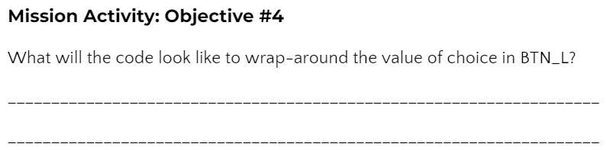
Mission Activity #4
DO THIS:
Go to your Mission Log and write down what you think the code should look like to wrap-around the value of choice in BTN_L

Slide 23
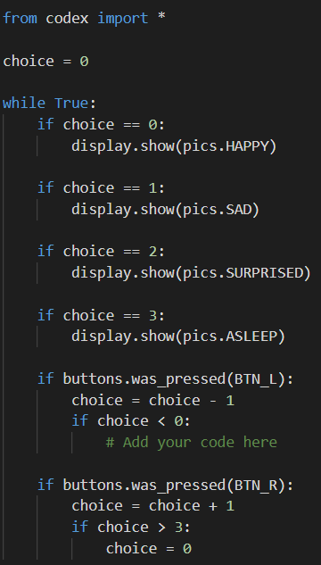
Mission Activity #4
Modify your code
DO THIS:
Add an if statement to BTN_R so the value of choice wraps around
Add an if statement to BTN_L so the value of choice wraps around
Test your code
Then stop the code

Slide 24
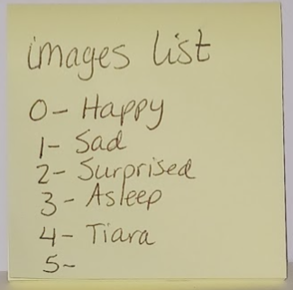
Objective #5: Image list
Four pictures is nice, but what if you want to add more?
That is a lot of typing!
Every new image needs an if statement
Your code can get very long very quickly!
Instead, you can make a list!

Slide 25
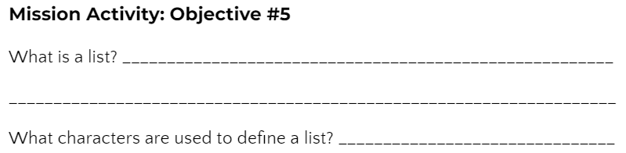
Mission Activity #5
DO THIS:
Click on in the instructions panel
Go to your Mission Log and answer the questions about list

Slide 26
Objective #5: Image list
A list is a type!
Now you know six data types:
  Integer
  CodeX image
  String
  Boolean
  Float
  List

Slide 27
Objective #5: Image list
INDEX | ITEM
0 | HAPPY
1 | SAD
2 | SURPRISED
3 | ASLEEP
4 | TIARA
5 | PLANE
The order of the items in the list is important
Each item has an index (number) assigned
The first index is always 0
The last index is always 1 less than the number of items
NOTE: This list has 6 items, so the index is 0, 1, 2, 3, 4, and 5

Slide 28
Objective #5: Image list
Things you can do with a list:
Create a list (use [ ])
my_list = [pics.HAPPY, pics.SAD, pics.SURPRISED, pics.ASLEEP, pics.TIARA]
Access an item in the list (use [ ])
my_image = my_list[1]
my_image = pics.SAD
my_image = my_list[choice]
my_image = whatever image is
at the current value
of choice
INDEX | ITEM
0 | HAPPY
1 | SAD
2 | SURPRISED
3 | ASLEEP
4 | TIARA

Slide 29
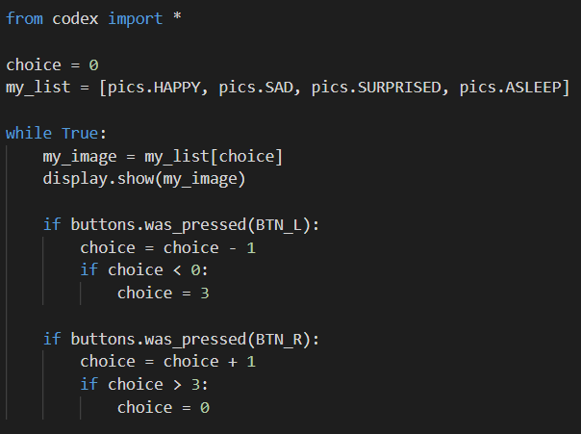
Mission Activity #5
DO THIS:
Add a list to your code
  Use the same four images
Change the code to access the list
  Add two lines of code to access the list using choice for the index
  Delete the four if statements that displayed the images
  Leave the if statements for BTN_L and BTN_R

Slide 30


Objective #6: No magic numbers
With four images in your list, the index numbers are
  0, 1, 2, 3
You use these numbers for wrap-around
If you added another image, the last index would be 4, not 3.
You would have to change 3 to 4 everywhere in the code!
These literals are called “magic numbers”

Slide 31

Objective #6: No magic numbers
Magic numbers make the code harder to maintain, and harder to read and understand.
The magic number in this program is the last index of the list
So …
Use a built-in function!
This code will give the length of the list, which is the number of items in the list.
Remember: the last index is always one less than the number of items

Slide 32

Mission Activity #6
Now you can add more images
DO THIS:
Add another image to your list
  A list of images is on slide 9
Create a variable for LAST_INDEX
Continued on next slide
You can choose the image you want to add

Slide 33
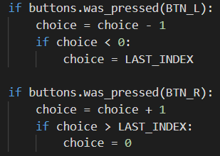
Mission Activity #6
DO THIS:
Use the LAST_INDEX variable in the code:

Slide 34
List len quiz
During this mission you have learned about lists and using an index to access its items.
Answer the quiz question about the list index
CODEX
QUIZ

Slide 35
Objective #7: Text time!
Images are expressive … but text can say so much more!
You can use a string variable to create a message or slogan
Remember: a string data type uses quotation marks: “..”
  my_message = “Meh”
  my_message = “Having a great day”
You also include a string message in your list
  display.show(my_message) will display the text string

Slide 36
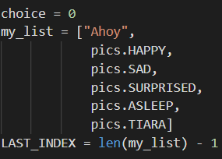
Mission Activity #7
DO THIS:
Add a text string to your list
OPTIONAL: Your list can look like this to make it easier to read.

Slide 37
Objective #8: Green with envy
What if you're neither HAPPY nor SAD? ...and text just isn't describing you?
Sometimes you just need a color.
Maybe you are GREEN with envy!
Wouldn't it be cool to fill the display with a color?
Try it out!

Slide 38
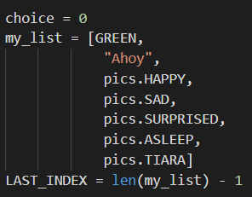

Mission Activity #8
DO THIS:
Add GREEN to the list
Run the program
Get an error?
Find out why in the next objective

Slide 39
Objective #9: Fill ‘er up
GREEN isn’t an image or a string. What type is it?
Colors in the codex library are actually tuples!
A tuple is like a list that can't be changed.
CodeX color tuples have three integer values:
(red, green, blue)
You learned about RGB values in Mission 3
What do you think the tuple for GREEN is?

Slide 40

Mission Activity #9
DO THIS:
Go to the Mission Log and write your guess for the RGB tuple of GREEN

Slide 41
Objective #9: Fill ‘er up
display.show() doesn’t work with colors, but display.fill() does!
You just have to know when to use display.show() and when to use display.fill()
You need to check for the type
You can use the console panel to help you

Slide 42

Mission Activity #9
DO THIS:
Open the console panel. You can type commands directly into the console.
Check the type of several values:
  type(7) -> ‘int’
  type(1.15)
  type(True)
  type([1, 2, 3])
The type is shown like this:
Now get the type of a color
  type((0, 255, 0))

Slide 43
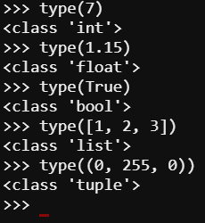
Objective #9: Fill ‘er up
The type of a color is ‘tuple’
You can use this information in your code
If the type is ‘tuple’,
use display.fill()
else
use display.show()

Slide 44
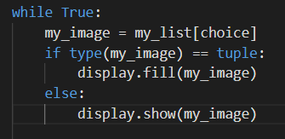
Mission Activity #9
DO THIS:
Add an if statement to the code that compares the current my_image to a tuple.
If it is, use display.fill()
Else use display.show()
Run the code. You should get colors, text and images!

Slide 45
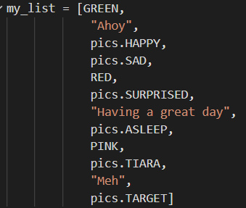
Mission Activity #9
DO THIS:
Add more colors, text or images to your list.
Run the code.
No matter how many items you have, the code should work without making any other changes.
Pretty cool, Right!
Now you can display your mood by stopping on the color, text, or image that represents you.

Slide 46
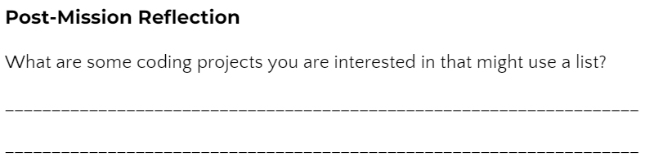
Post-Mission Reflection
Read the “completed mission” message and click to complete the mission
Complete the Mission 7 Log

Slide 47
Clearing your CodeX
Go to FILE -- BROWSE FILES
Select the “Clear” file and open it
Run the program to clear the CodeX

